Slide 1
Master-Thesis Methodical Approach for Analyzing Process Parameters and Optimizing Boundary Conditions in Multi-Axis Robot Programs
Status Update: Week 08+09 (15 weeks left)
20.11.2023 – 03.12.2023
Jan Nalivaika

Slide 2
State of the Art Questions
Continuous-path mode ???
Changes: -
-
-
-
G-Code ??
Add / No Add

Slide 3
Writing progress
Methodology == Done ☺

Slide 4
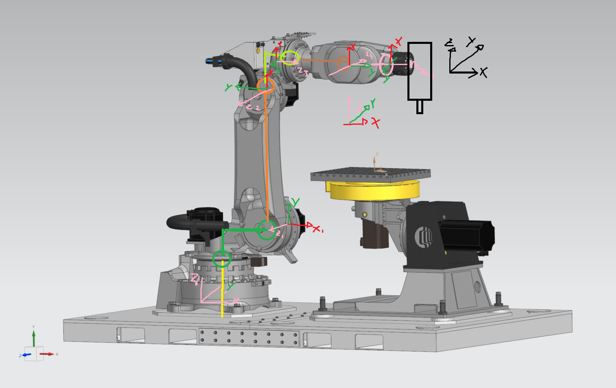
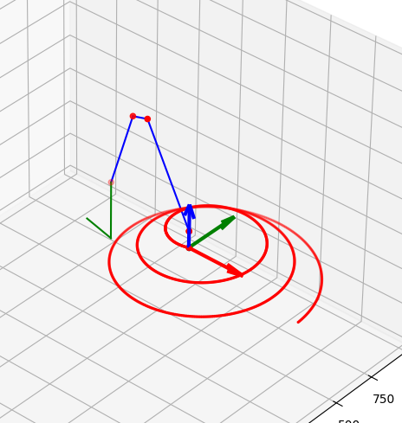
Robot Problems
DH parameters ?!?!?
Correct inverse kinematic algorithm ? – work in progress

Slide 5
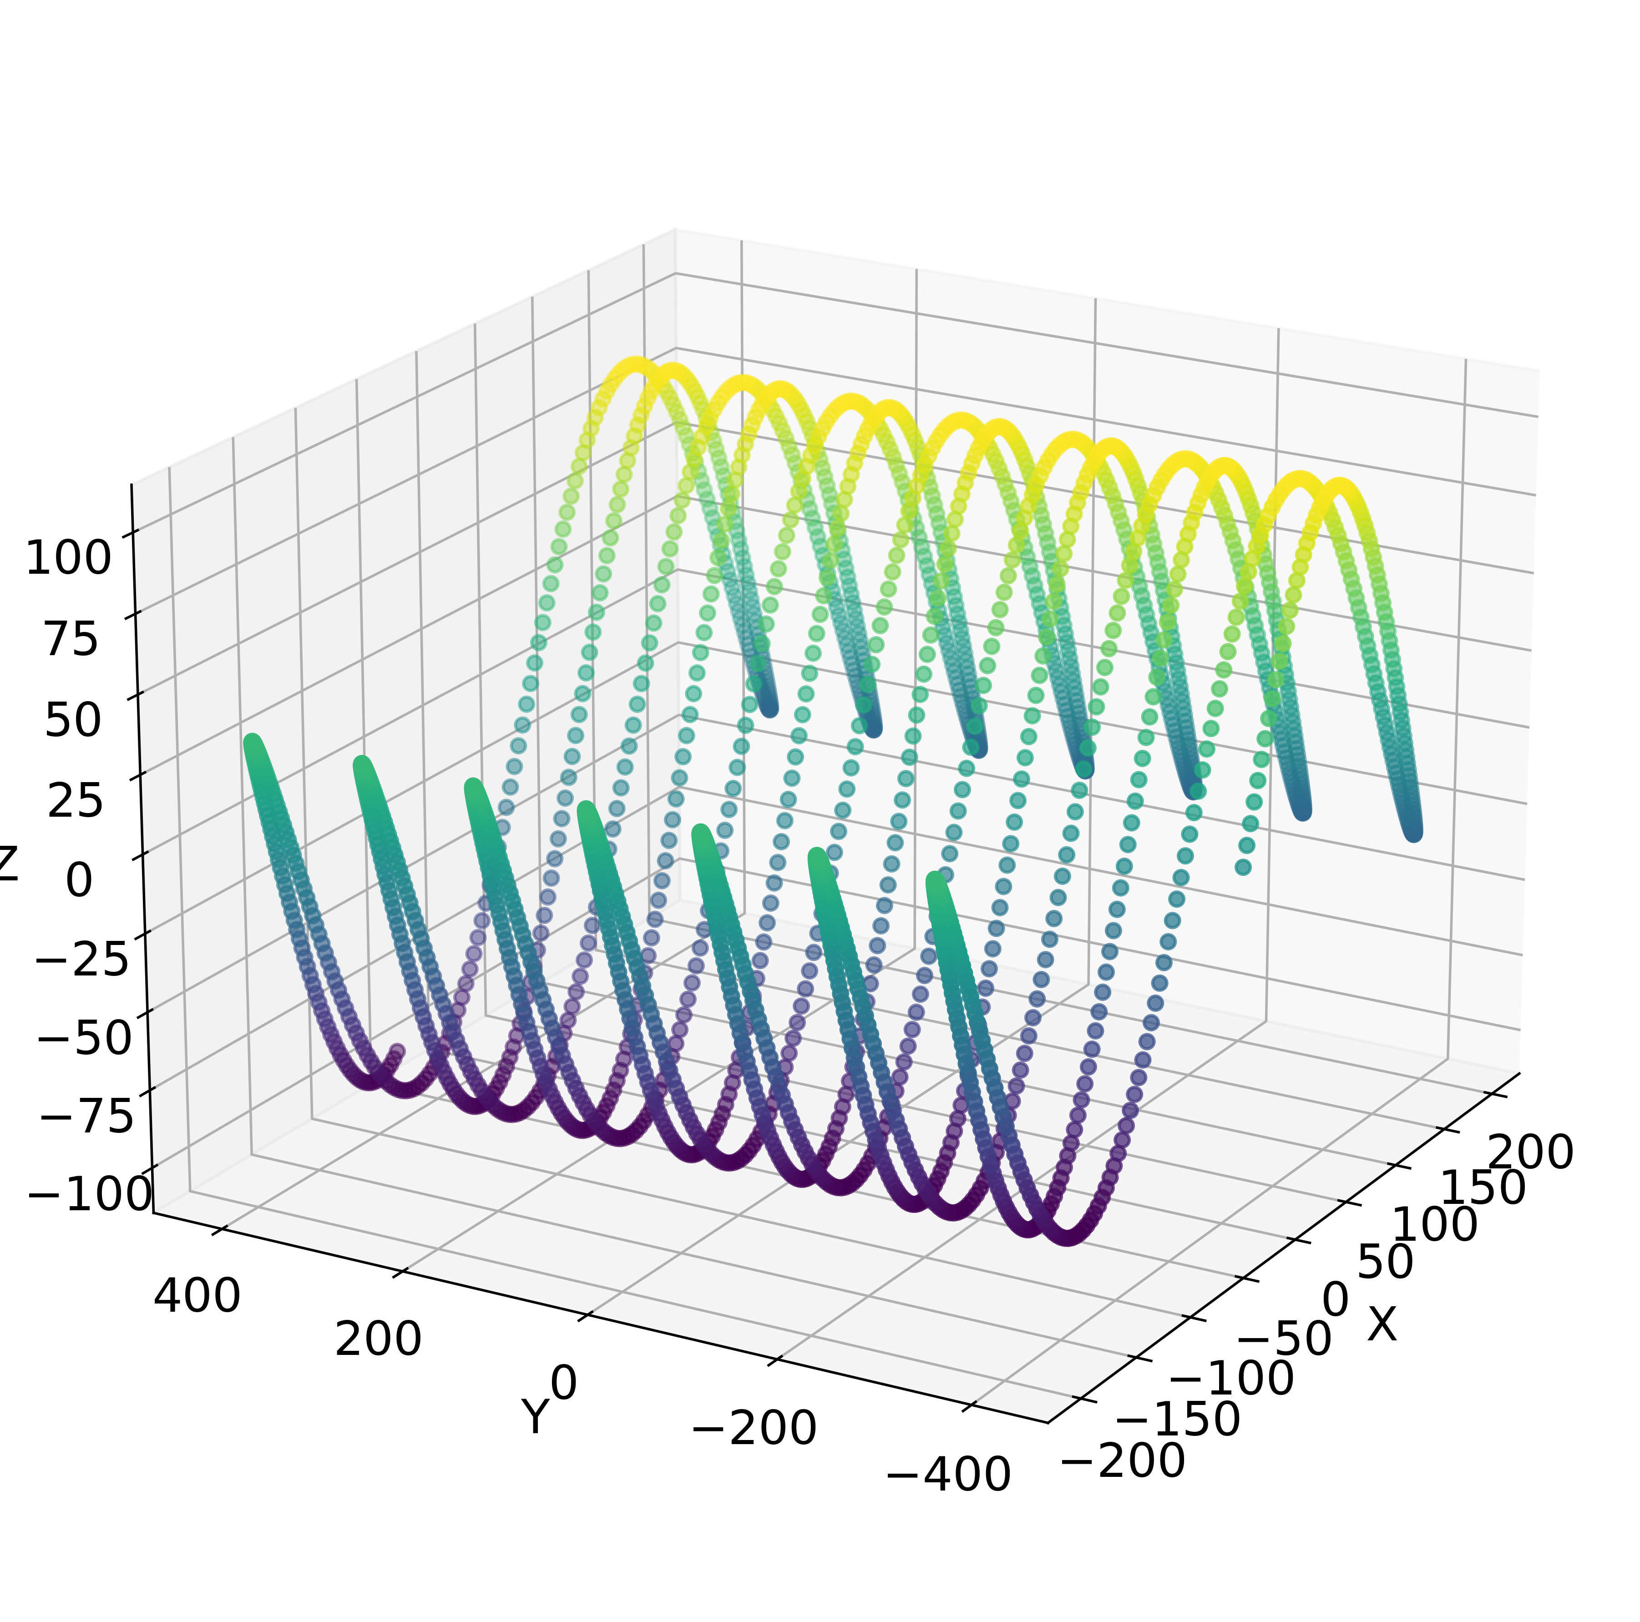
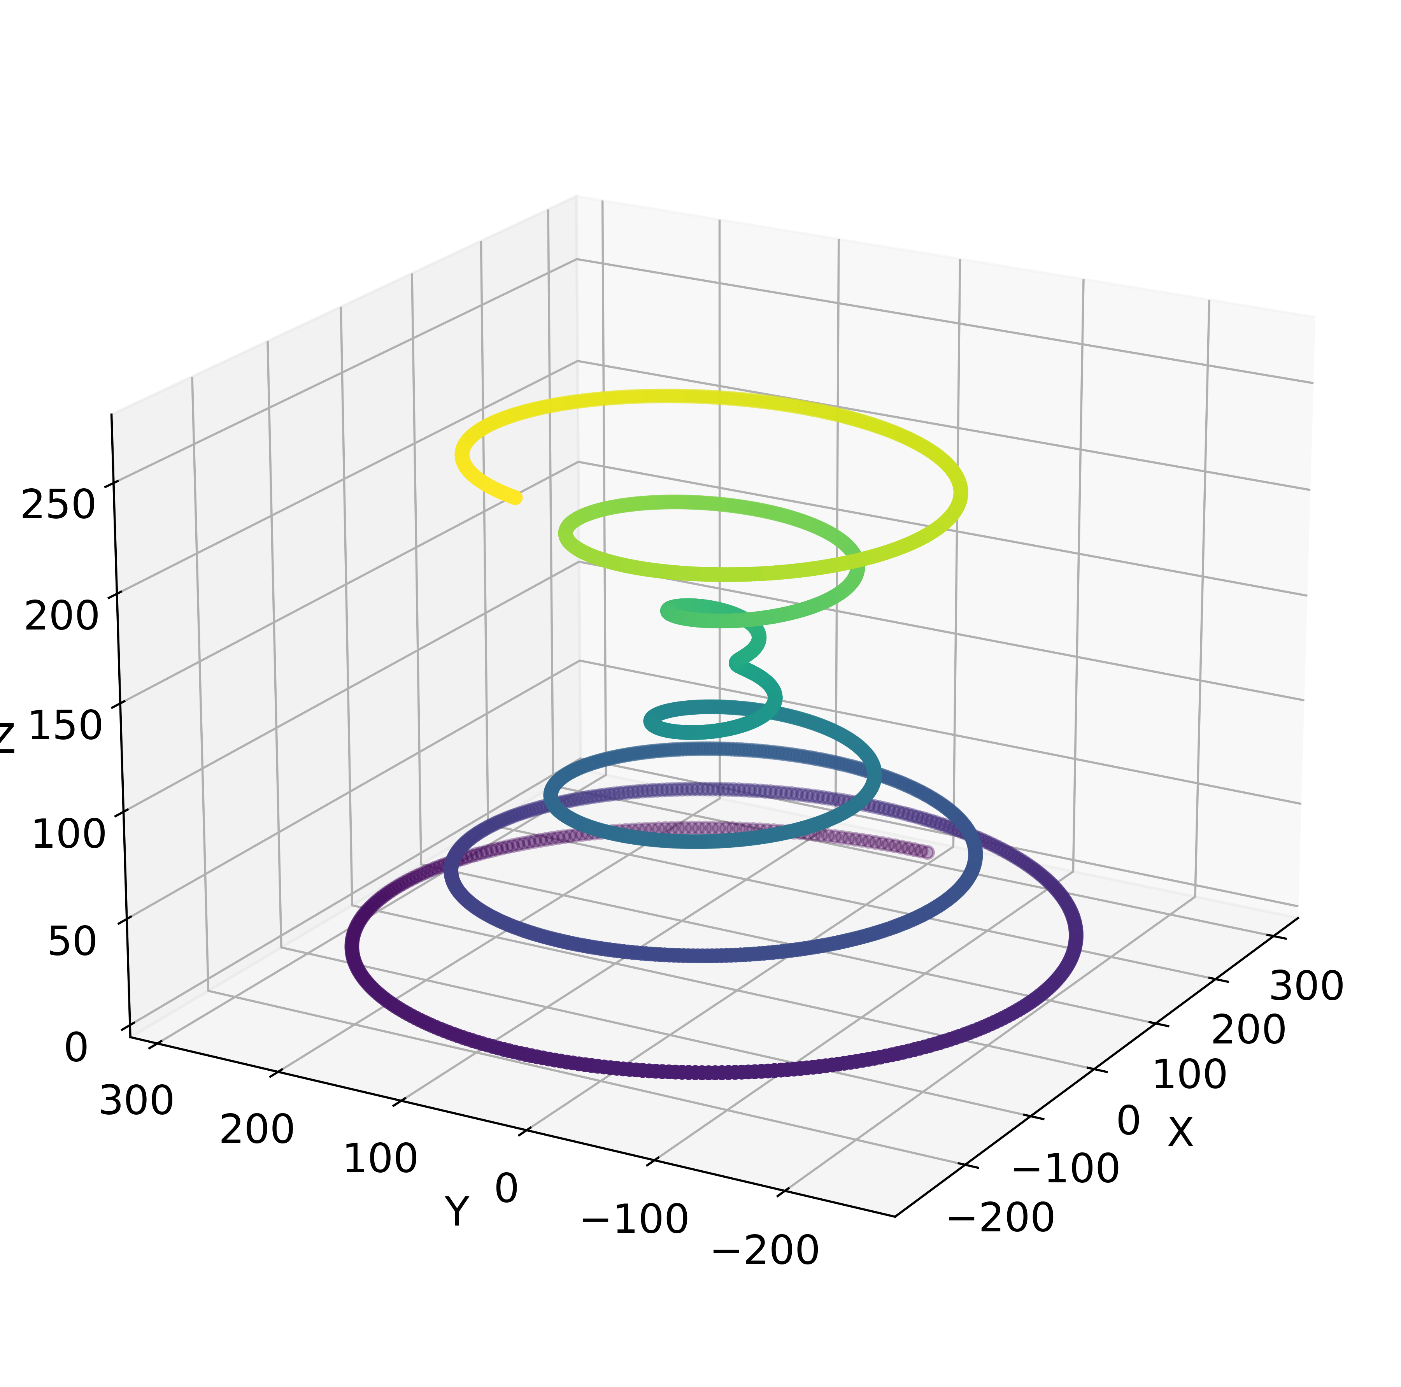
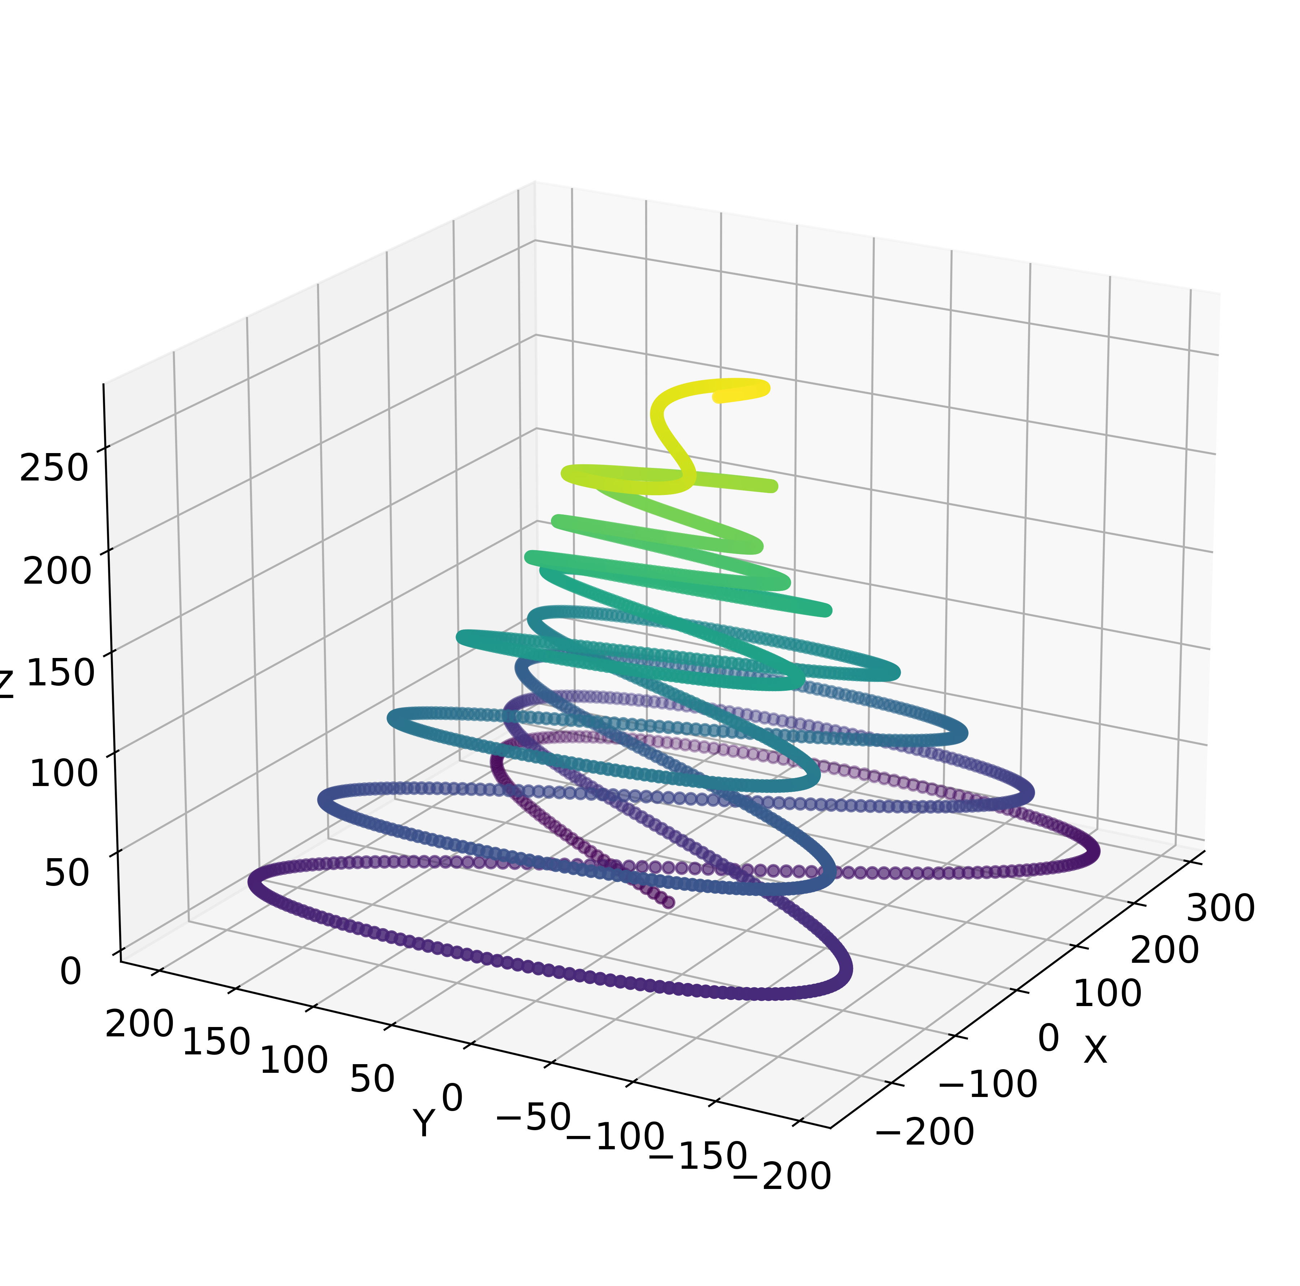


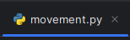

Python progress:

Slide 6
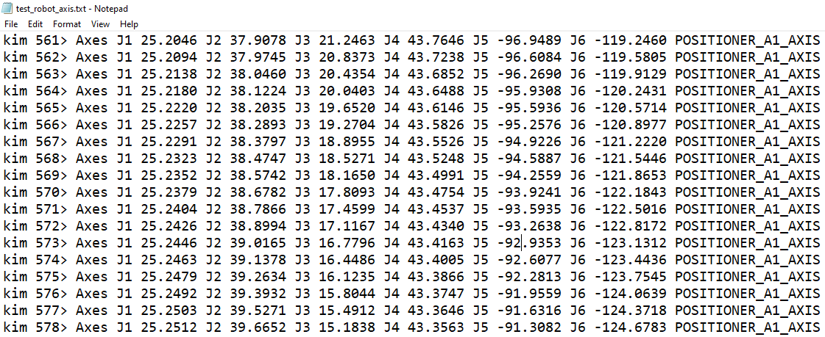
NX Problems
Values do exist
BUT
Only as a Debug-Variable – only in development version of NX

Slide 7
Christmas planning
DATE: Ludwig Marius Jan
08.12 ☺
15.12 ☺
22.12 ☺
29.12 X ☺
05.01 ☺
12.01 ☺
19.01 X
26.01 X
02.02 ☺

Slide 8
ToDo:
Einheiten in img

Slide 9
Contact
Jan Nalivaika (TUM) Student Otto-Hahn-Ring 6
81739 Munich, Germany
Phone +49 163 7180148
E-mail jan.nalivaika.ext@siemens.com nalivaika@outlook.de
Marius Breuer (Siemens AG)
Supervisor Otto-Hahn-Ring 6
81739 Munich, Germany
Phone +49 (172) 8396287
E-mail marius.breuer@siemens.com
Ludwig Siebert (TUM-IBW)
Supervisor Boltzmannstr. 15
85748 Garching at Munich
Phone +49 (89) 289 – 15578
E-mail ludwig.siebert@iwb.tum.de

Slide 10
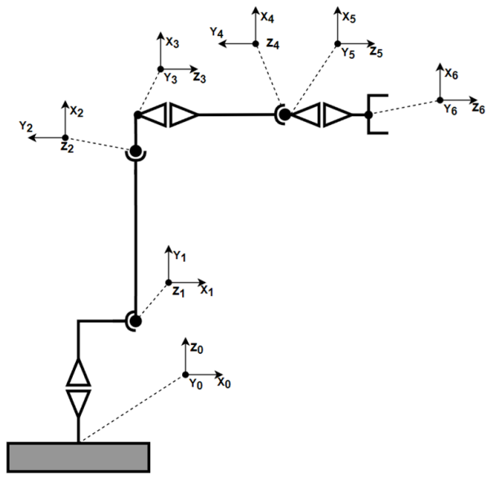
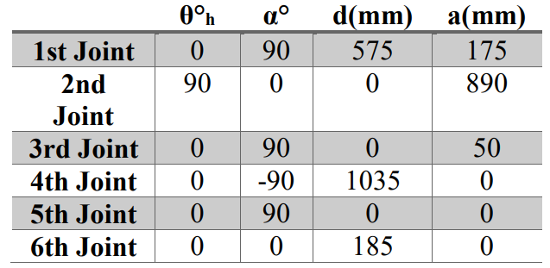
890
575

